Slide 1

STORE SALES ANALYSIS
COMPREHENSIVE ANALYSIS
Group 1
Nancy Eldeeb
Yousef Khaled
Omar Hussein
Mohamed Khaled

Slide 2

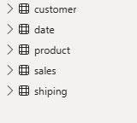
ABOUT THE
DATA
One Master Sheet contains all data after Normalization we have Reational Dataset
consists of 4 Dim TBLs & 1 Fact TBL.

Slide 3
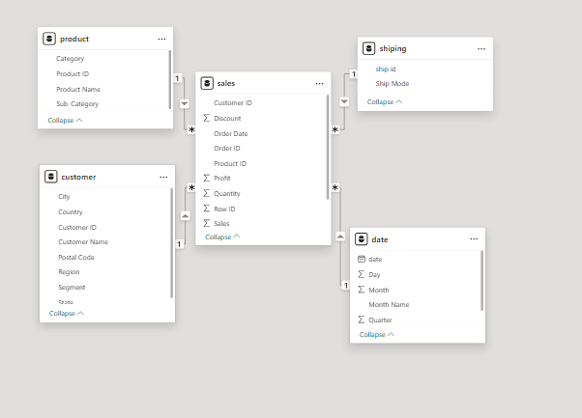
DATA MODEL
Performed Data Modeling in Power BI to establish relationships between tables, optimize data structure, and ensure accurate reporting

Slide 4
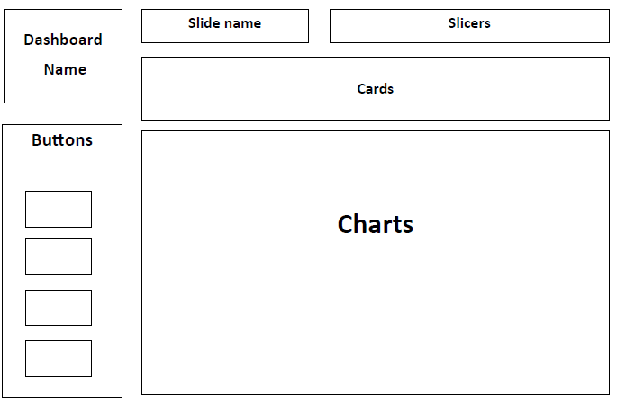
WIREFRAME
Performed a Wireframe to setup Dashboard Structure

Slide 5

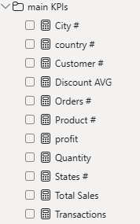
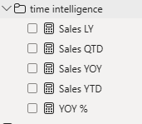
MEASURES
Main KPIs
Time Intelligence

Slide 6

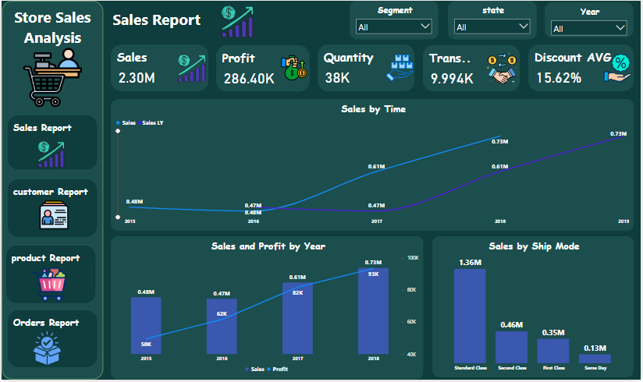
LANDING PAGE

Slide 7
SALES REPORT - OVERVIEW
•This dashboard shows overall company performance.
- KPIs: Sales $2.3M, Profit $286K, Quantity 38K, Transactions ~10K, Discount Avg 15.6%
- Filters: Segment, State, Year
Summary: Sales performance is positive with moderate profit margins.
Conclusion: Profitability is under pressure due to high discounts.
Recommendation: Revisit discount strategies to improve profit margins.

Slide 8
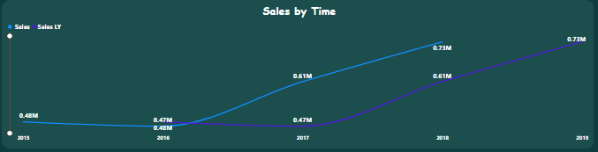
SALES TREND
•The line chart compares Sales vs. Last Year Sales.
Insights:
- Sales trend increased significantly after 2016.
- 2018 marked the highest growth.
Conclusion: Positive sales momentum.
Recommendation: Invest in sustaining year-over-year growth.

Slide 9
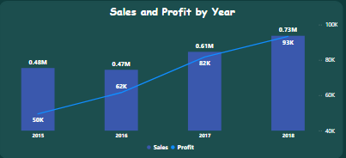
SALES & PROFIT BY YEAR
•Combo chart compares yearly Sales vs. Profit.
Insights:
- Both Sales and Profit increased from 2015 to 2018.
- Profit peaked at $93K in 2018.
Conclusion: Strong upward profitability trend.
Recommendation: Scale high-margin categories to strengthen profits further.

Slide 10
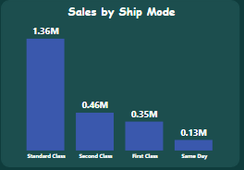
SALES BY SHIP MODE
•Breakdown of sales by shipping mode.
Insights:
- Standard Class dominates with $1.36M.
- Same Day sales minimal ($0.13M).
Conclusion: Customers prefer Standard shipping.
Recommendation: Optimize shipping logistics to maintain efficiency.

Slide 11
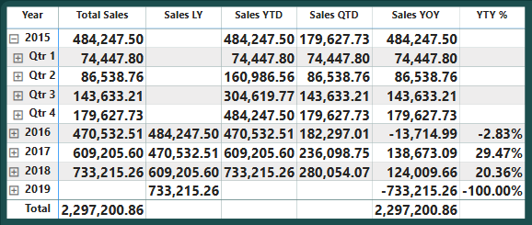
TIME INTELLIGENCE
Matrix shows :
Sales Vs Last Year Sales
YTD Sales
QTD Sales
Sales Growth Year over Year
Growth %

Slide 12
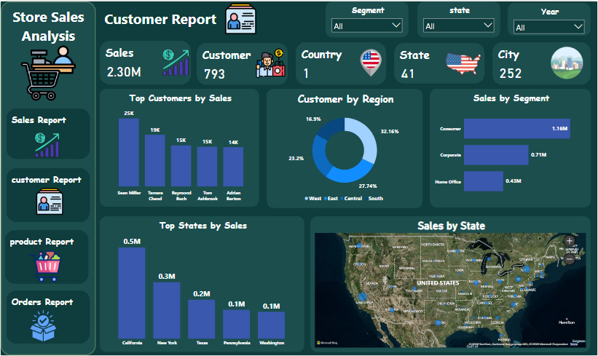
CUSTOMER REPORT - OVERVIEW
•Customer KPIs: Sales $2.3M, 793 Customers, 41 States, 252 Cities.
Summary: Wide customer base across many regions.
Conclusion: High geographic coverage.
Recommendation: Segment customers for targeted strategies.

Slide 13
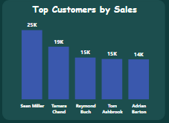
TOP CUSTOMERS
•Top 5 customers drive significant revenue.
Insights:
- Sean Miller: $25K
- Tamara Chand: $19K
Conclusion: Revenue is concentrated among top customers.
Recommendation: Strengthen loyalty programs for key accounts.

Slide 14
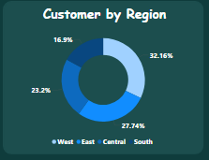
CUSTOMERS BY REGION
•Donut chart distribution:
- East 32%
- Central 28%
- South 23%
- West 17%
Conclusion: East region leads in sales.
Recommendation: Target growth in underperforming regions (West).

Slide 15
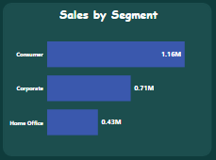
SALES BY SEGMENT
•Sales split:
- Consumer: $1.16M
- Corporate: $0.71M
- Home Office: $0.43M
Conclusion: Consumer segment drives majority.
Recommendation: Strengthen corporate sales channel.

Slide 16
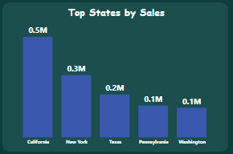
SALES BY STATE
Top States: California $0.5M, New York $0.3M.

Slide 17
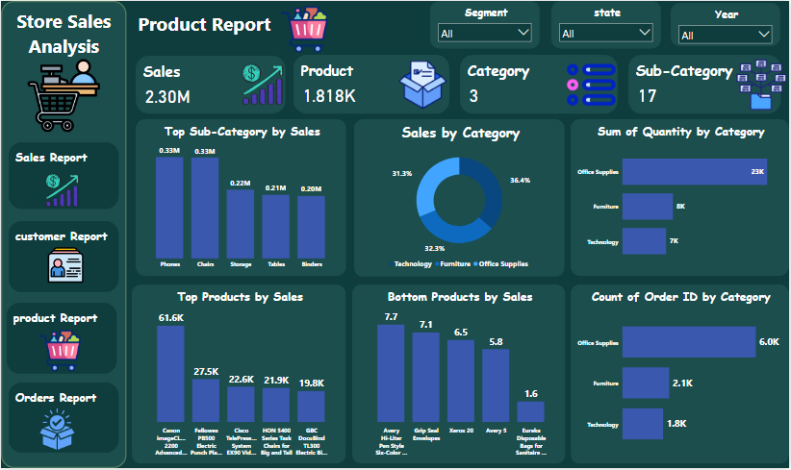
PRODUCT REPORT - OVERVIEW
•KPIs: $2.3M Sales, 1818 Products, 3 Categories, 17 Sub-Categories.
Conclusion: Product portfolio is diverse.
Recommendation: Focus on high-margin sub-categories.

Slide 18
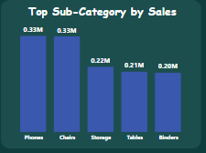
TOP SUB-CATEGORIES
•Top Sub-Categories:
- Phones $0.33M
- Chairs $0.33M
- Storage $0.22M
Conclusion: Phones and Chairs are best-performing.
Recommendation: Invest in scaling these sub-categories.

Slide 19
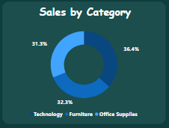
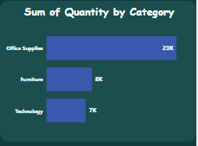
SALES & QUANTITY BY CATEGORY
Sales split:
- Technology 36%
- Furniture 32%
- Office Supplies 31%
Quantities:
- Office Supplies 23K units
Conclusion: Office Supplies high volume, low value.
Recommendation: Shift focus to Technology for value growth

Slide 20
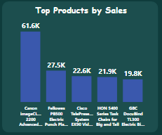
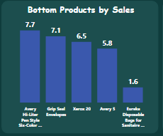
TOP & BOTTOM PRODUCTS
•Top Product: Canon imageCLASS ($61K).
Bottom: Eureka Disposable Bags ($1.6K).
Conclusion: Few products dominate sales.
Recommendation: Discontinue weak products, boost leaders.

Slide 21
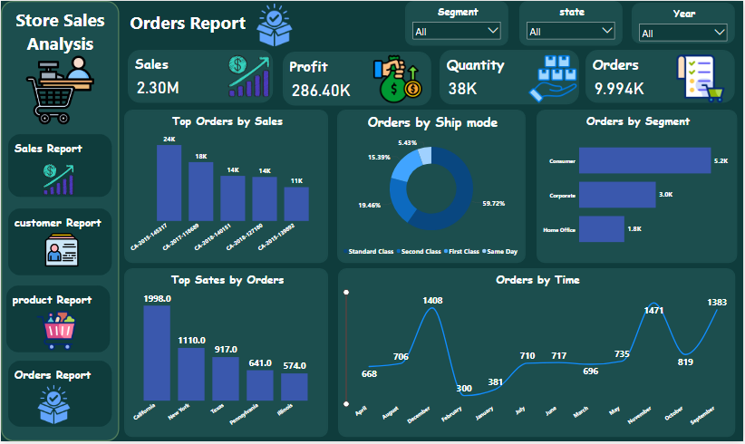
ORDERS REPORT - OVERVIEW
•KPIs: Sales $2.3M, Profit $286K, Quantity 38K, Orders ~10K.
Conclusion: Healthy order volume.
Recommendation: Enhance order fulfillment speed.

Slide 22
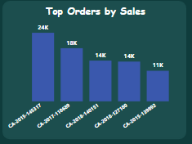
TOP ORDERS
•Top Orders range $11K–24K.
Conclusion: Few large orders drive sales.
Recommendation: Prioritize key orders with dedicated service.

Slide 23
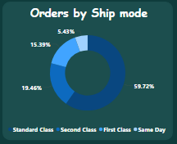
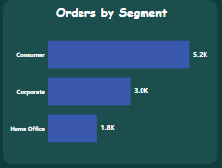
ORDERS BY SHIP MODE & SEGMENT
•Ship Mode: Standard Class 60%, Second Class 19%, First Class 15%.
Segments: Consumer 5.2K orders.
Conclusion: Consumer + Standard shipping dominate.
Recommendation: Ensure consistent shipping service.

Slide 24
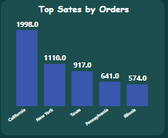
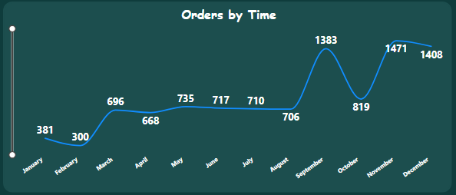
TOP STATES & ORDERS TREND
•Top Orders by State: California 2K, NY 1.1K.
Orders by Time: Peaks in Nov (1471), Dec (1408).
Conclusion: Strong seasonality around holidays.
Recommendation: Prepare supply chain for Q4 surge.

Slide 25
Overall Summary - Sales
•Sales grew strongly post-2016.
Discounts erode margins.
Recommendations:
- Optimize discount policy.
- Maintain shipping efficiency.
- Continue growth strategies.

Slide 26
Overall Summary - Customers
•Customers concentrated in few accounts and East region.
Recommendations:
- Diversify across regions.
- Invest in loyalty programs.
- Expand corporate client base.

Slide 27
Overall Summary - Products & Orders
•Product portfolio shows leaders & laggards.
Orders highly seasonal.
Recommendations:
- Invest in top products.
- Phase out weak SKUs.
- Prepare for Q4 surge.

Slide 28
Final Recommendations
•1. Reduce discount dependency.
2. Expand in underperforming regions.
3. Focus on top customers and products.
4. Improve supply chain efficiency.
5. Leverage seasonality for promotions.

Slide 29

THANK YOU

